Slide 1
Databrary
A Repository for Storing, Managing, and Reusing Video Data
Andrew Gordon
Information Engineer
New York University

Slide 2

Intended Community
Developmental Psychology
Researchers studying humans using video

Slide 3
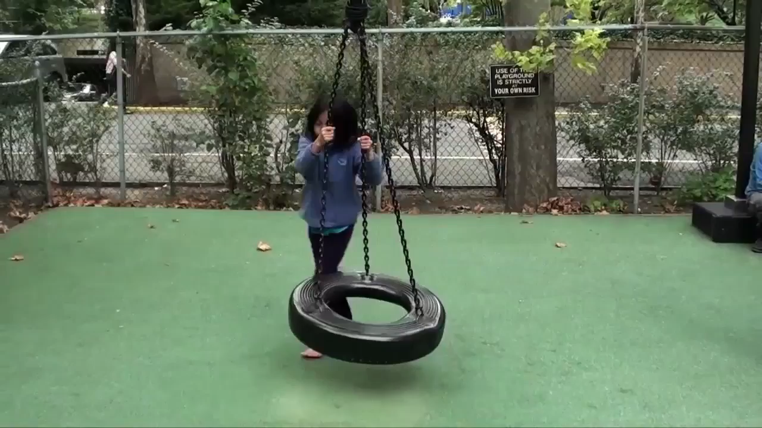
Video as Data

Slide 4
Some Background
Funded for open sharing and reuse of video data by NIH and NSF
Hosted by Steinhardt School at NYU with help from NYU Libraries and ITS
Started early 2013, opened for general use October 2014

Slide 5

Contribution Statistics
As of May 2015:
8200 video files
2700 hours of video
2400 records including 2100 human subjects
35 contributors, 121 total authorized users
69 institutions world-wide

Slide 6
A Caveat (or two)
Focus on research practices and how to encourage more data contributions
Not designed to be a turnkey system (yet)

Slide 7
Challenge - Ethics
Satisfying the ethical obligations for human subject data
Many stakeholders involved

Slide 8
Solution - Ethics
Cohesive, standard policies around sharing and reusing data
Documentation and template language
Let researchers start with sharing in mind

Slide 9
Access Restrictions
Release Levels
Private: This content has not been shared and is restricted to collaborators
Authorized Users: This content is restricted to authorized Databrary users
Excerpts: This content is restricted to authorized Databrary users, who may use it in presentations for informational or educational purposes
Public: This content is available openly to anyone

Slide 10
Challenge - Supporting Community
Managing diverse datasets
Meeting researchers where they work
Making sharing easy

Slide 11
Solution - Supporting Community
New expectations
Cultural shift
Staff work directly with researchers and their IRBs

Slide 12
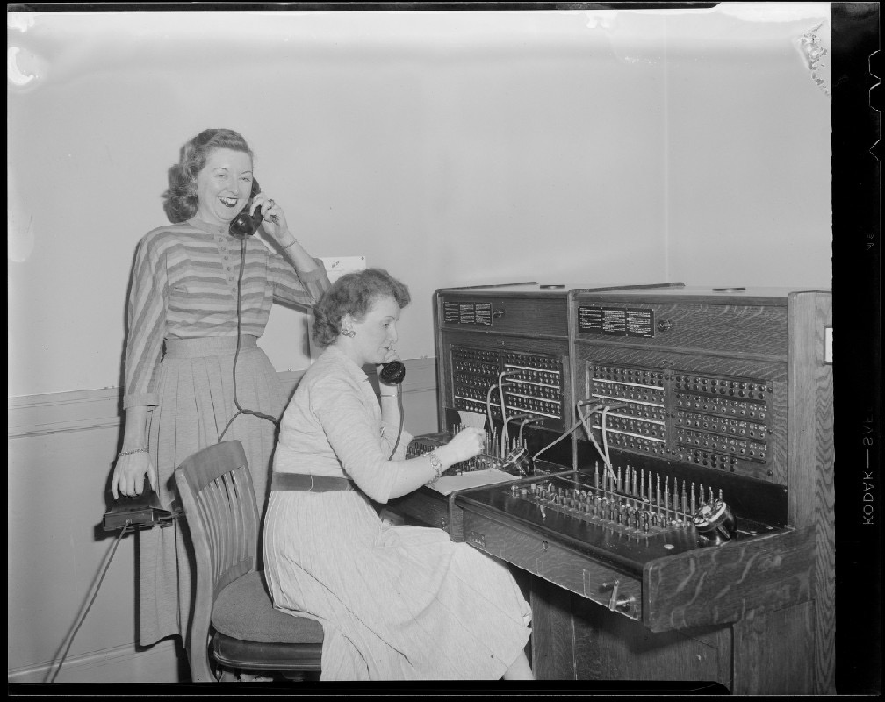
Image Source: http://ark.digitalcommonwealth.org/ark:/50959/nz8061582 Copyright (c) Leslie Jones.

Slide 13
Challenge - Data Curation
Curating data is labor intensive
Researchers have limited time and resources

Slide 14
Image Source: http://ark.digitalcommonwealth.org/ark:/50959/nz8061582 Copyright (c) Leslie Jones.

Slide 15
Image Source: http://ark.digitalcommonwealth.org/ark:/50959/nz8061582 Copyright (c) Leslie Jones.

Slide 16
Image Source: http://ark.digitalcommonwealth.org/ark:/50959/nz8061582 Copyright (c) Leslie Jones.

Slide 17
Solution - Data Curation
Post hoc curation
Capturing and standardizing metadata
Obtaining consents on older datasets
Standardized ingest workflows

Slide 18
Solution - Data Curation
Self-curation
Online tools to support researcher curation at source
Fits to common researcher practices

Slide 19
Challenges - Infrastructure
Video data are large, difficult to share and store
Standardizing storage and access of video data and metadata

Slide 20
Solutions - Infrastructure
Dataset designed to map to research study
Components of datasets mapped to how researchers organize their data
Minimal metadata for maximum contributions

Slide 21
Future Directions - Near term
More refined and faceted search
Provide DOIs for datasets
Support more diverse file formats
Regional workshops

Slide 22
Future Directions - Long Term
Provide more support for existing research workflows online
More interoperability with discovery systems

Slide 23
https://databrary.org

